Slide 1
Презентация на тему: «First aid for wounds, bruises and fractures.»
Аркадакский филиал государственного автономного профессионального
образовательного учреждения Саратовской области «Саратовский областной базовый медицинский колледж»
Подготовила:
преподаватель иностранного языка
Курилова Елена Геннадьевна
Аркадак, 2024

Slide 2
Plan:
First aid for bleeding.
First aid for bruises.
First aid for fractures.
List of sources used.

Slide 3
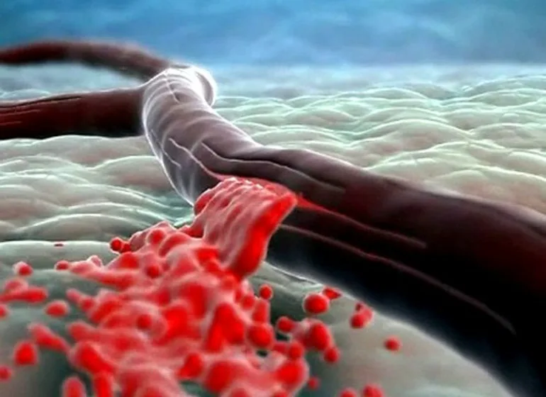
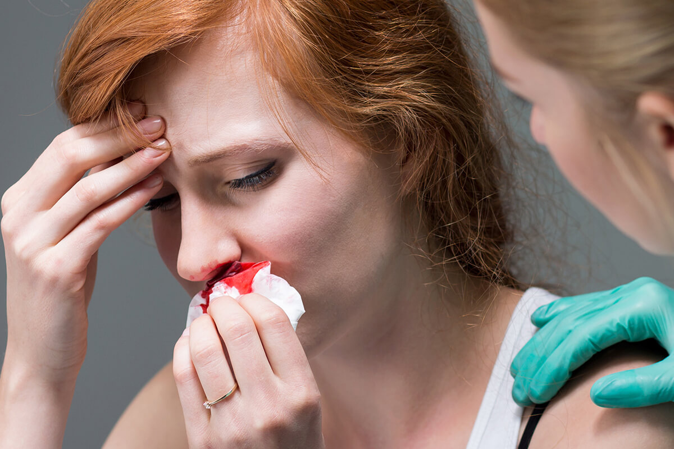
1. First aid for bleeding.
Bleeding is the outpouring of blood into the external environment, the natural cavities of the body, organs and tissues.

Slide 4
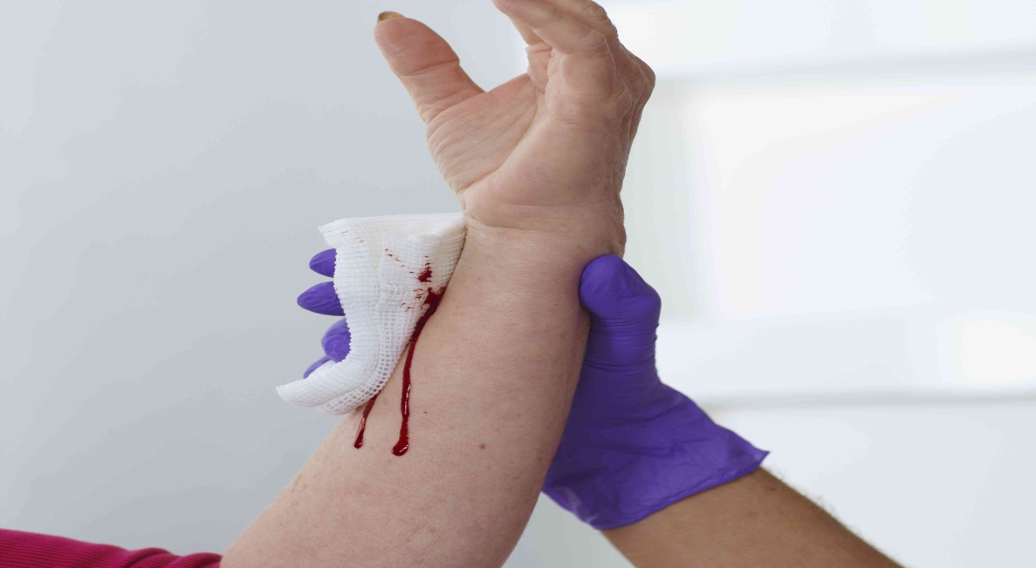
Classification
External bleeding - into the external environment. There is a visible source in the form of a wound, an open fracture or crushed soft tissues.
Internal bleeding - into one of the natural cavities of the body, communicating with the external environment: bladder, lung, stomach, intestines.
Latent bleeding - in tissues or body cavities that do not communicate with the external environment: in the interfacial space, ventricles of the brain, joint cavity, abdominal, pericardial or pleural cavities.

Slide 5
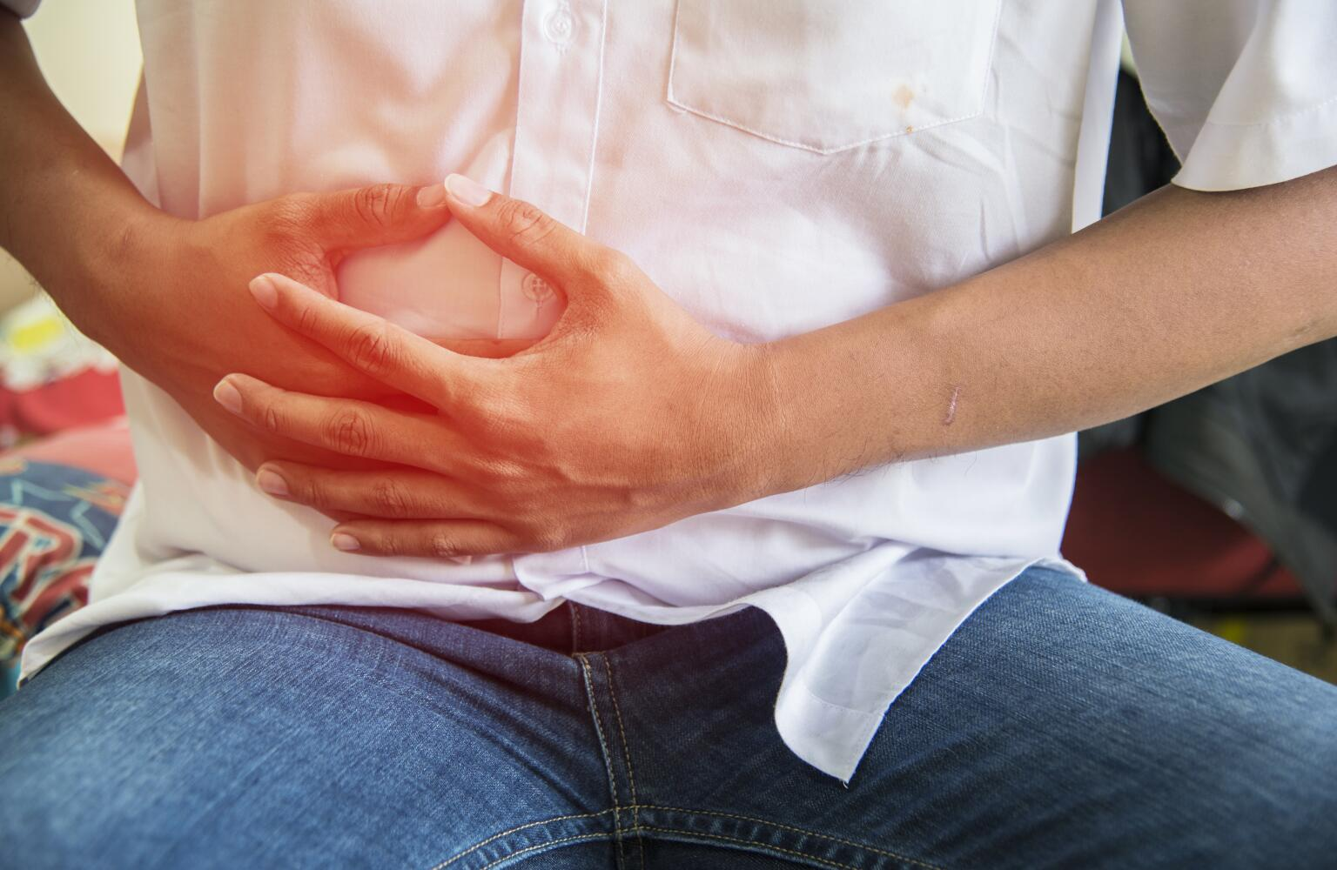
Symptoms of bleeding
Common signs of pathology include dizziness, weakness, shortness of breath, severe thirst, pallor of the skin and mucous membranes, decreased blood pressure, increased pulse (tachycardia), pre-fainting and fainting.
Hidden bleeding is the most dangerous and the most difficult in terms of diagnosis, they can be detected only by indirect signs.

Slide 6
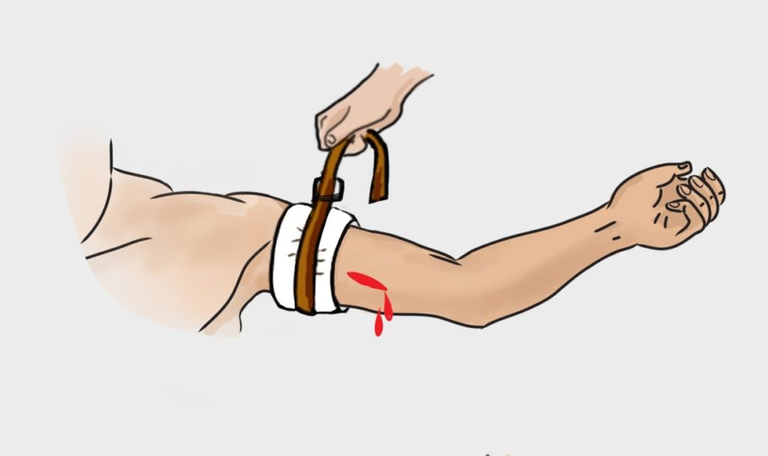
First aid for arterial bleeding
Carotid artery - press your palm to the back of the victim's neck and press the fingers of the other hand on the artery.
The brachial artery is easily accessible, it must be pressed against the humerus.
It is quite difficult to stop the blood from the subclavian artery. To do this, take the victim's arm back and press the artery located behind the collarbone to the first rib.
The axillary artery must be pressed hard with your fingers to squeeze, because it is located quite deep.
The femoral artery is very large, it must be pressed against the femur with a fist. If this is not done, the victim may die in 2-3 minutes.
The popliteal artery should be pressed into the generational fossa, which does not require much effort.

Slide 7
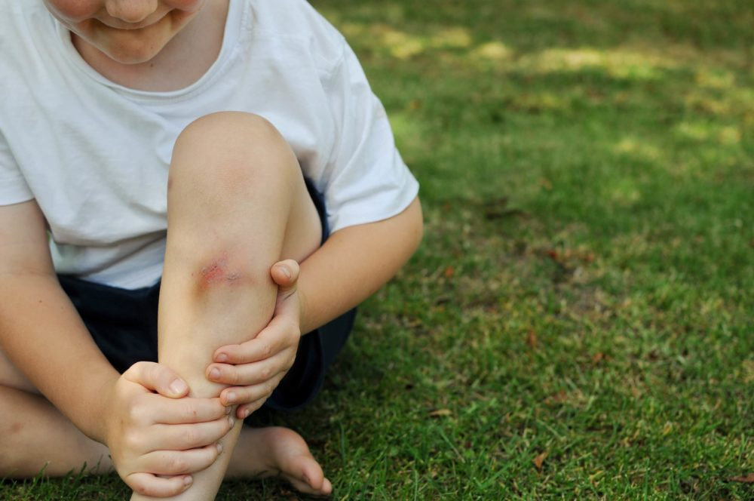
2. First aid for bruises.
Bruise — injury of soft tissues of a closed nature. This is a common injury. It appears after a blow and affects only the upper layers of the skin, but a severe bruise can injure the periosteum.

Slide 8
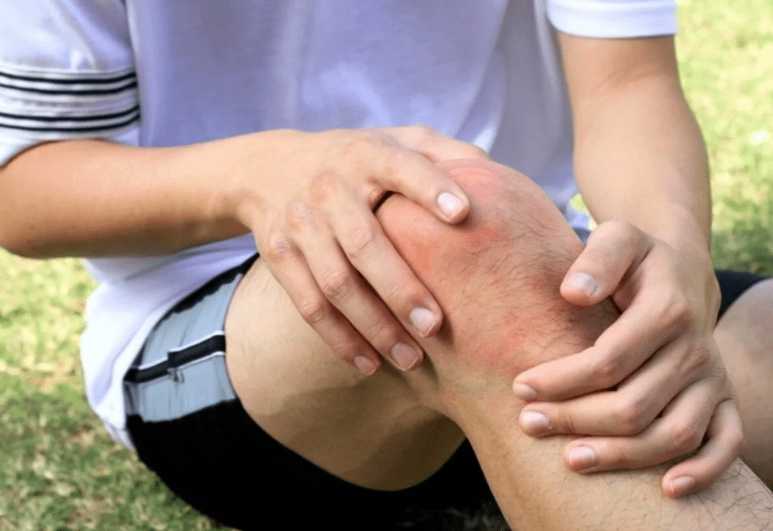
Reasons
The main reasons are a fall from a height or a blow from a blunt object. For example:
-carelessness when handling heavy and bulky objects;
-falling while descending the stairs;
-a traffic accident when the driver or passengers were not wearing seat belts;
-falling as a result of severe dizziness or fainting;
-martial arts classes.

Slide 9
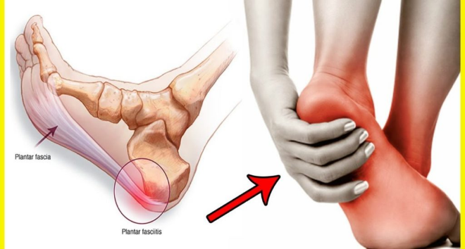
Symptoms of injury
The symptoms depend on the location of the injury. The following common features are distinguished:
severe pain in the affected area
rupture of blood vessels, which provokes subcutaneous hemorrhage
bruising
swelling of the bruised area
loss of sensitivity for several hours
change of intense pain to aching
increased pain 2-3 hours after injury due to hematoma

Slide 10
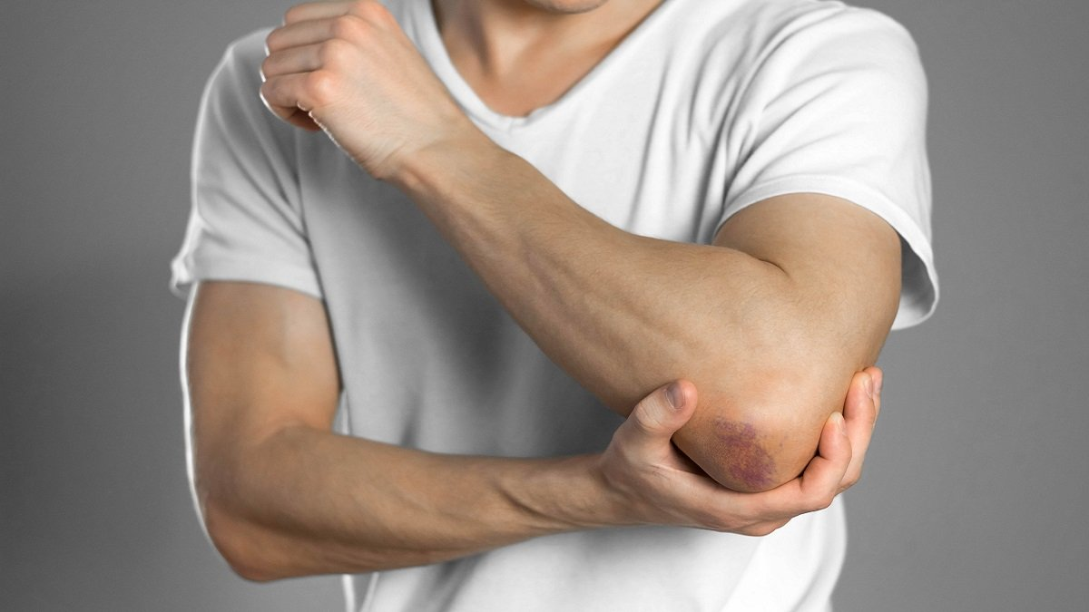
Stages of injury development There are four degrees of soft tissue damage:
the first is characterized by minor injuries — shallow abrasions and scratches. The pain disappears in the first day
the second is a rupture of muscle tissue, hematoma and edema. Accompanied by acute pain
the third implies damage to bone tissue, damage to tendons and muscle tissues
the fourth is characterized by pronounced changes. The affected area is not able to function normally, you need to see a doctor urgently

Slide 11
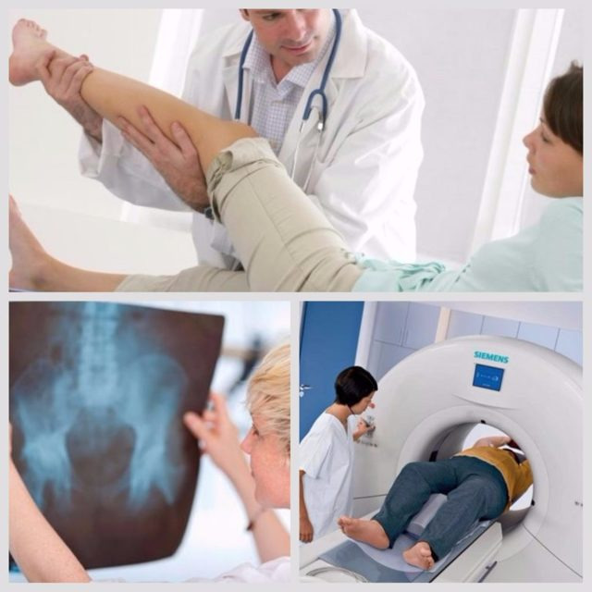
Diagnostics
A visual examination is sufficient to diagnose a bruise. The doctor examines the patient's body, probes the injured area and determines the functionality of muscle and joint tissues.
In case of bruising of internal organs, radiography, ultrasound or MRI are prescribed.

Slide 12
First aid for bruises
First aid is provided to relieve pain in case of bruising, eliminate swelling and prevent the formation of a hematoma. The most common recommendation is to apply a cold compress to the injury site. For example, a rag soaked in cold water. The compress needs to be changed as it heats up.
If the hand is injured, the affected area is wrapped with a cotton cloth, after which a cold compress is applied. In case of severe damage, a fixing bandage is applied.
If a finger is damaged, ice cubes massage the affected area for 10-15 minutes. After injury to soft tissues, you can not do a warming compress in the first 24 hours.
When the knee is bruised, the joint is placed in an elevated position and a fixing bandage is applied, cold is applied.
In case of head, back or chest injuries, the victim is put to bed and ice is applied to the affected area.

Slide 13
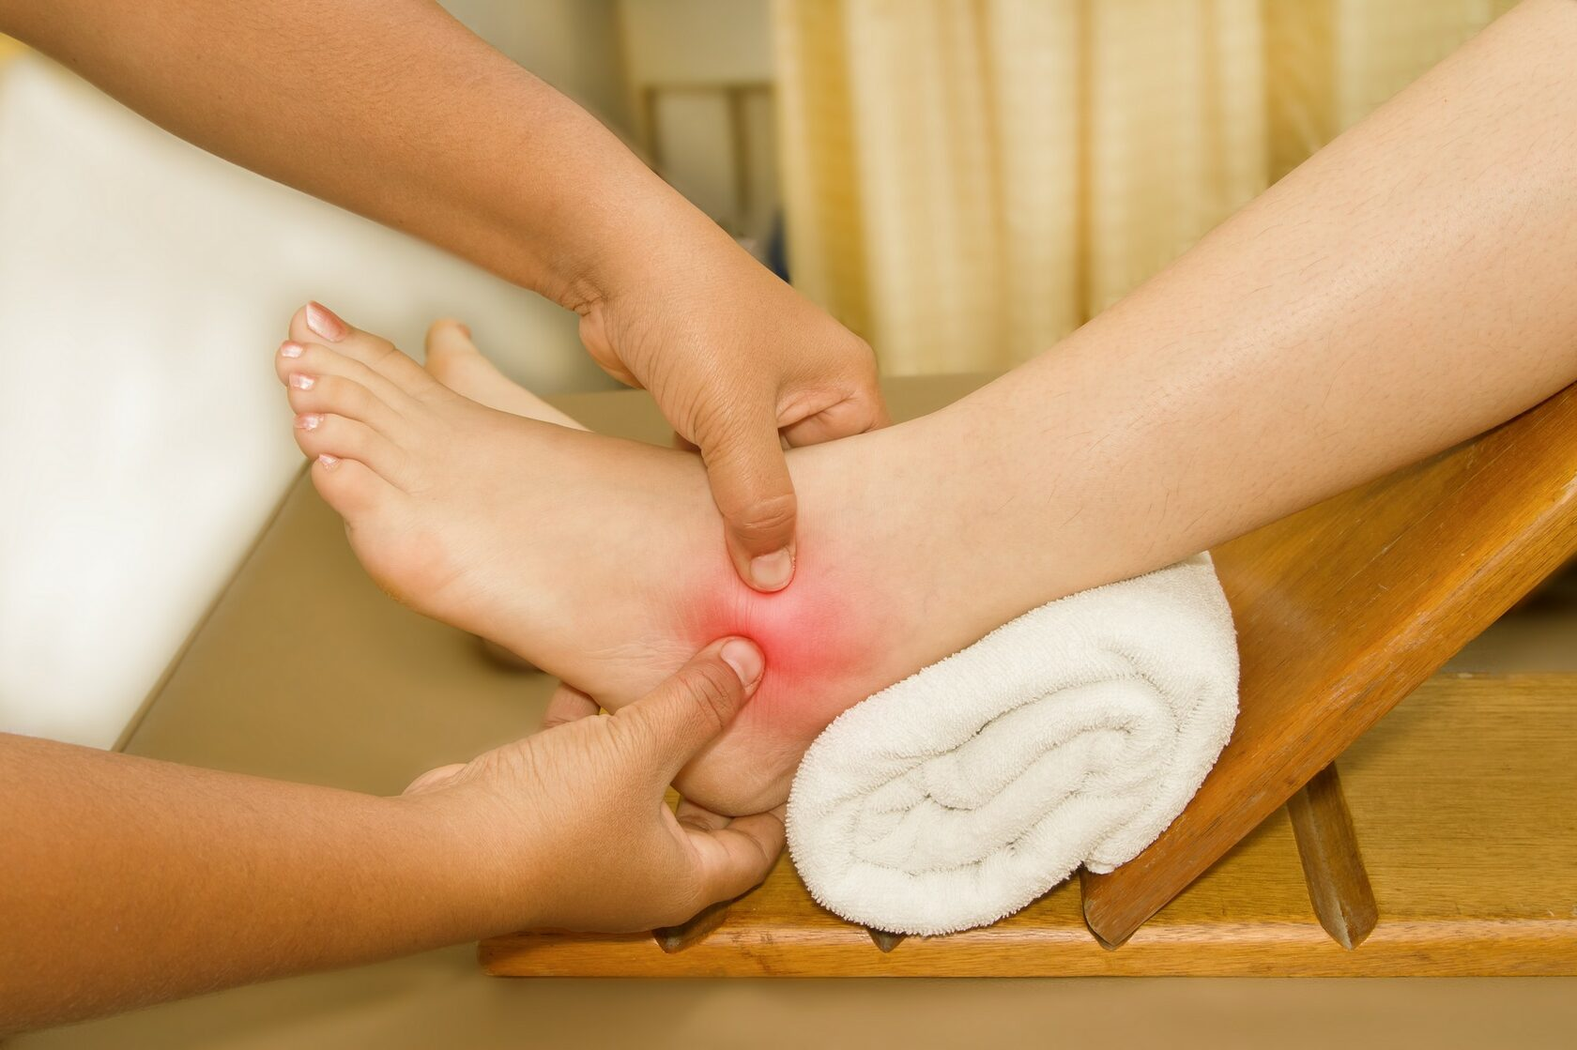
Treatment of bruises
Therapeutic massage accelerates the resorption of hematomas, reduces pain, eliminates swelling and heals tissues. The first sessions can last from 5 to 10 minutes. At the end of the course, the procedure may increase to 15-25 minutes. The massage course includes 12-15 sessions.

Slide 14
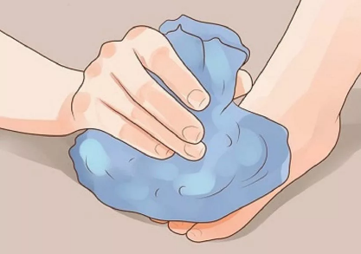
Medical treatment
Anti-edematous and anti-inflammatory effects are provided by nonsteroidal drugs. Hematomas can be eliminated with the help of gels and ointments from bruises based on heparin or leech extract. They have a warming effect and improve blood flow. Preparations based on snake and bee venom have a vasodilating effect.

Slide 15
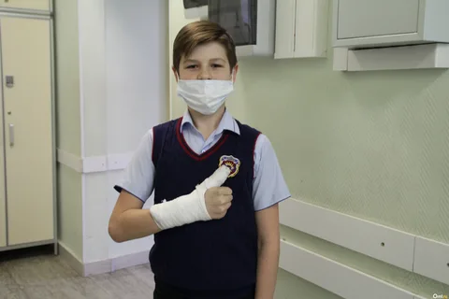
3. First aid for fractures.
Fractures of bones-are a violation of their integrity under the influence of external influences or traumatic factors.

Slide 16
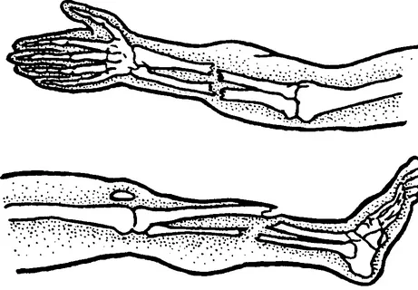
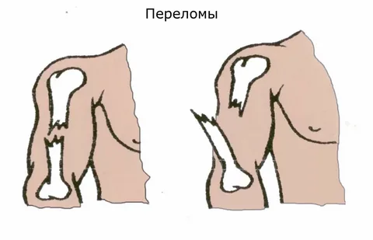
Fractures are divided into: -closed and(Both closed fractures and open fractures can be both with the displacement of fragments, and without their displacement; -open(An open fracture is always qualitatively different from a closed one, since it is bacterially contaminated, such a fracture can always end in suppuration. Treatment of open fractures is a separate section of traumatology).

Slide 17
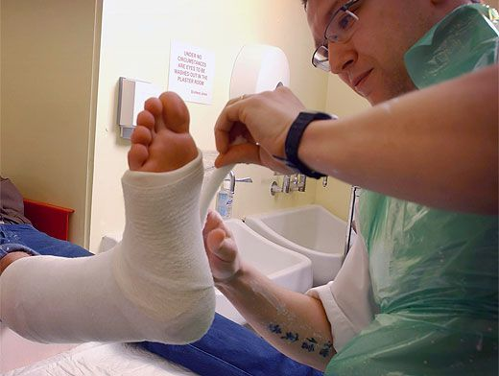
Signs of a fracture are: -pain -deformity of the limb at the site of the fracture -inability to move the limb -shortening of the limb -crunching of bone fragments under the skin -pain during axial pounding (along the bone) -with a fracture of the pelvic bones - the inability to tear the leg off the surface on which the patient lies.

Slide 18
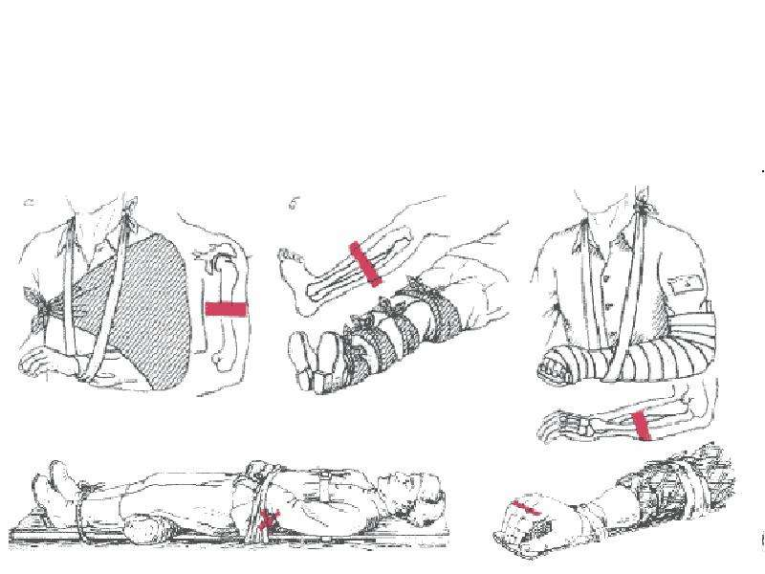
First aid for a closed fracture: -call an ambulance. -ensure the immobility of the injured limb, for example, put it on a pillow and ensure rest. -Put something cold on the supposed fracture zone. -the victim can be given hot tea or an anesthetic to drink. -apply a tire from any improvised materials (boards, skis, sticks, rods, umbrellas).

Slide 19
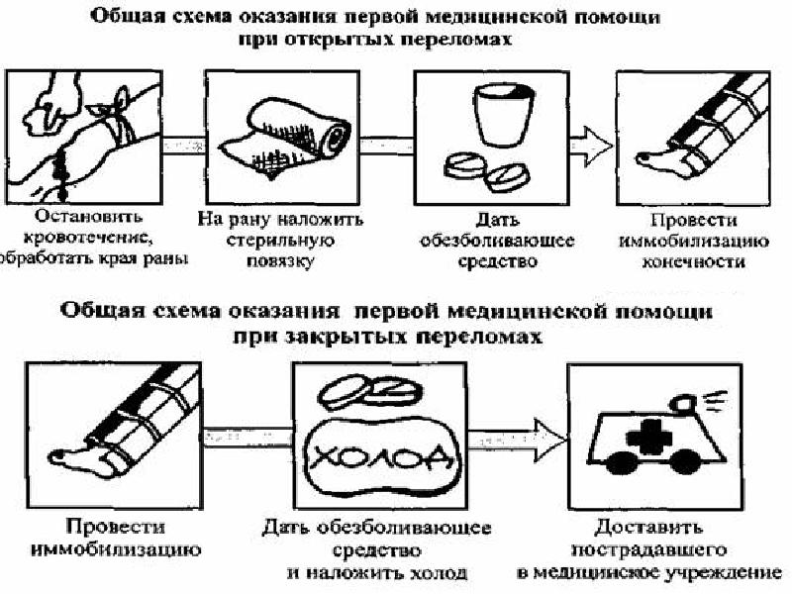
first aid for an open fracture is the same, but if there is bleeding, it must be stopped first by applying a tourniquet. The skin around the wound must be treated with an antiseptic (iodine).

Slide 20
4. List of sources used
https://urfu.ru/fileadmin/user_upload/common_files/docs_units/go_i_chs/obuchenie/Tema-6.-Okazanie-pervoi-pomoshchi..pdf
https://mchs.gov.ru/deyatelnost/bezopasnost-grazhdan/okazanie-pervoy-medicinskoy-pomoshchi_1
https://gemotest.ru/info/spravochnik/zabolevaniya/ushib-kak-otlichit-ot-pereloma-i-okazat-pervuyu-pomoshch/
https://kosterevo.ru/go-i-chs-informiruet/pomoshh-pri-perelomah-vyvihah-ushibah-i-rastyazheniyah-svyazok/
https://zavrb18.ru/upload/2018/pomoshpriperelome.pdf
https://em-clinic.ru/news/pervaya-pomoshch-pri-perelome/

